Slide 1

Revving Up Success: Strategic Insights from Auto Industry Data
Data-Driven Decisions for Future Mobility

Slide 2

Opening the Roadmap: An Introduction
Purpose of the Presentation:
Explore the automotive landscape through data analytics.
Identify trends, opportunities, and strategies for growth.
Overview of the Data:
Data sourced from comprehensive industry sales records.
Time period covered: 1990-2015.
Geographic scope: USA
Objectives for Today:
To uncover actionable insights that drive industry decisions.
To engage with the story the data tells us about past trends and future predictions.
Outline of the Presentation:
Starting with sales trends and moving through market analysis.
Concluding with strategic insights and actionable recommendations.

Slide 3
Industry Overview: Steering Through Recent Trends
Current Market State:
Major players and their market shares.
Sales volumes and revenue statistics.
Economic Impact:
The automotive industry's contribution to the economy.
Employment statistics.
Effects of global economic shifts on the industry.
Challenges & Opportunities:
Challenges: supply chain disruptions, changing emission regulations, the rise of electric vehicles.
Opportunities: new markets, innovations in mobility, and autonomous driving technologies.
Consumer Trends:
Increasing demand for sustainability.
Preferences for vehicle types, features, and innovations.
The impact of digitalization on consumer choices.

Slide 4
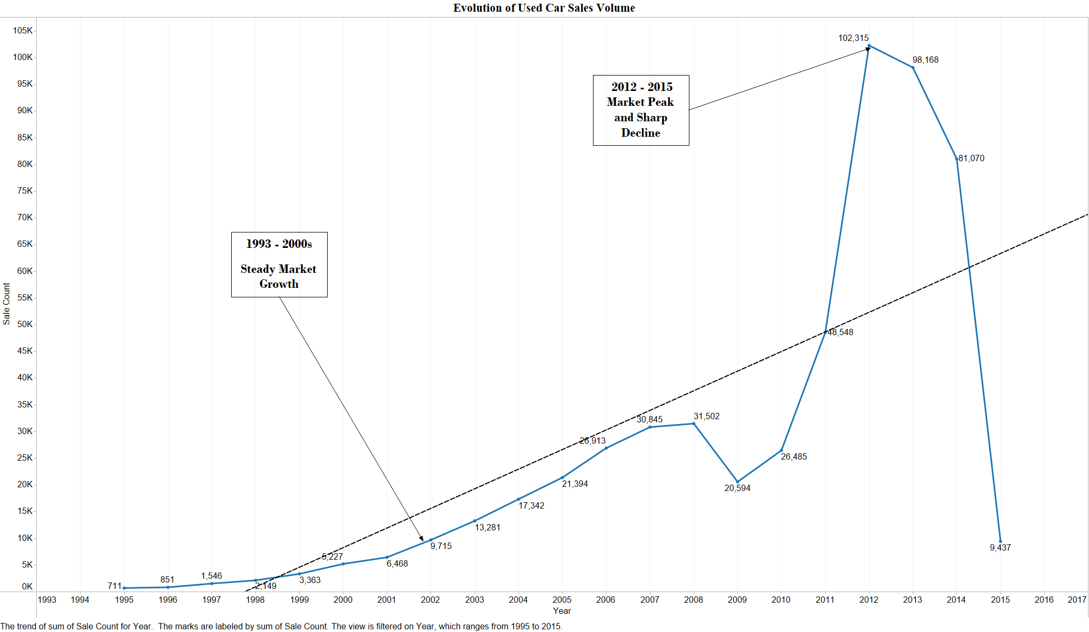

Slide 5
Competitive Dynamics: A Look at Manufacturer Rankings
Leading Brands: Top manufacturers by sales volume.
Rising Contenders: Emerging players in the market.
Market Strategies: Different strategies used by leading and emerging manufacturers to capture market share.
Innovation as a Driver: Innovation in product design, technology, and customer experience is influencing competitive positions.
Challenges to Leadership: Significant challenges that top manufacturers are facing, such as supply chain issues, changing regulations, or new entrants disrupting the market.

Slide 6
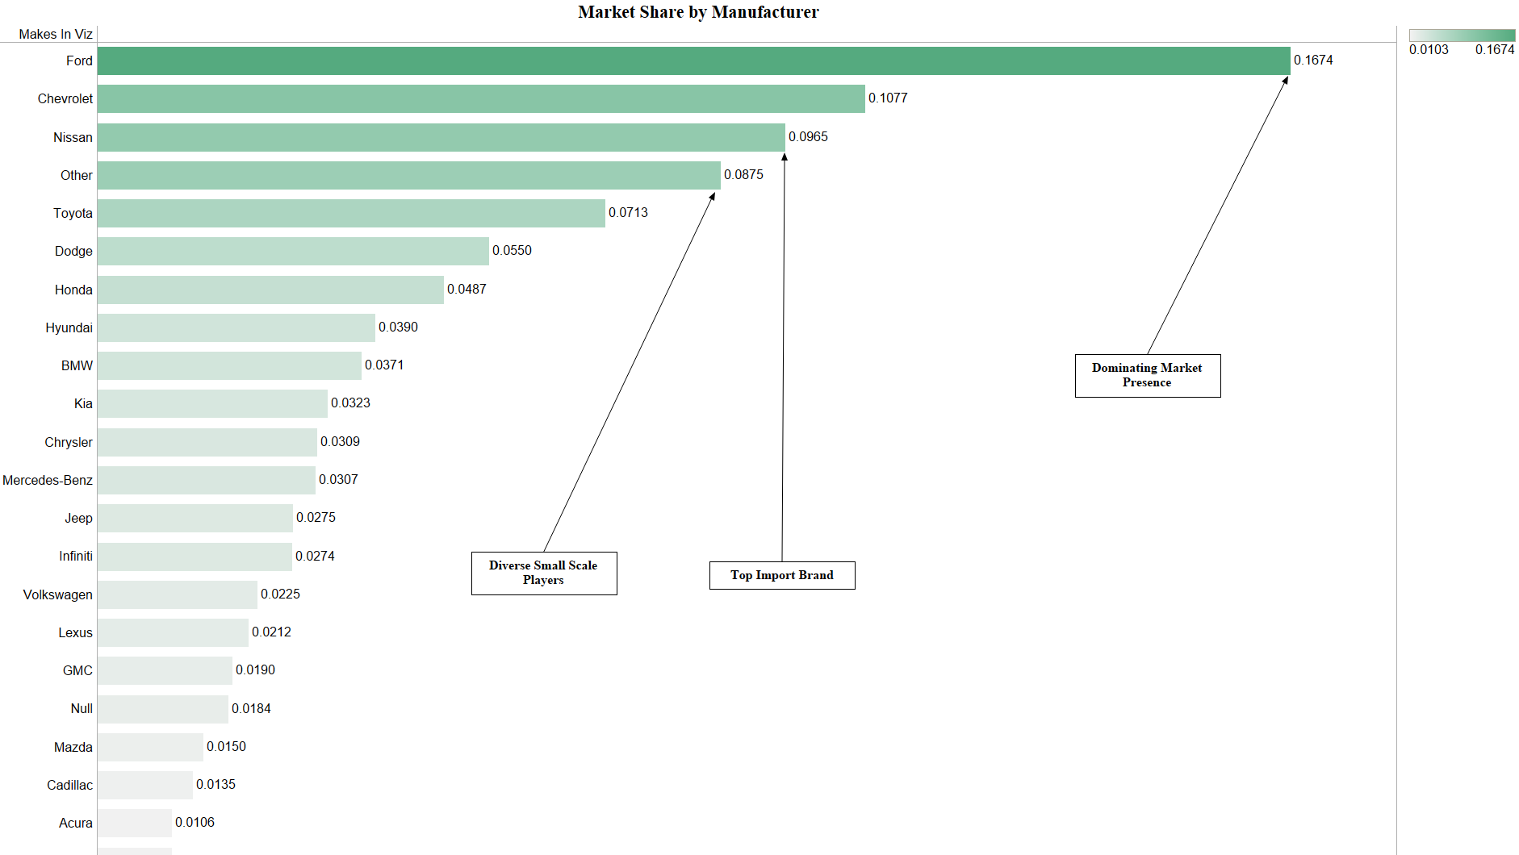

Slide 7

The Price-Condition Correlation: Valuing the Wheels
Impact of Condition: Condition of vehicles plays a crucial role in pricing strategies.
Price Variability: Variability in prices of new, used, and certified pre-owned vehicles.
Consumer Perception: Highlight vehicle condition influences consumer perception and decision-making.
Strategic Pricing: Dealers can use condition-based pricing to position their inventory advantageously.

Slide 8
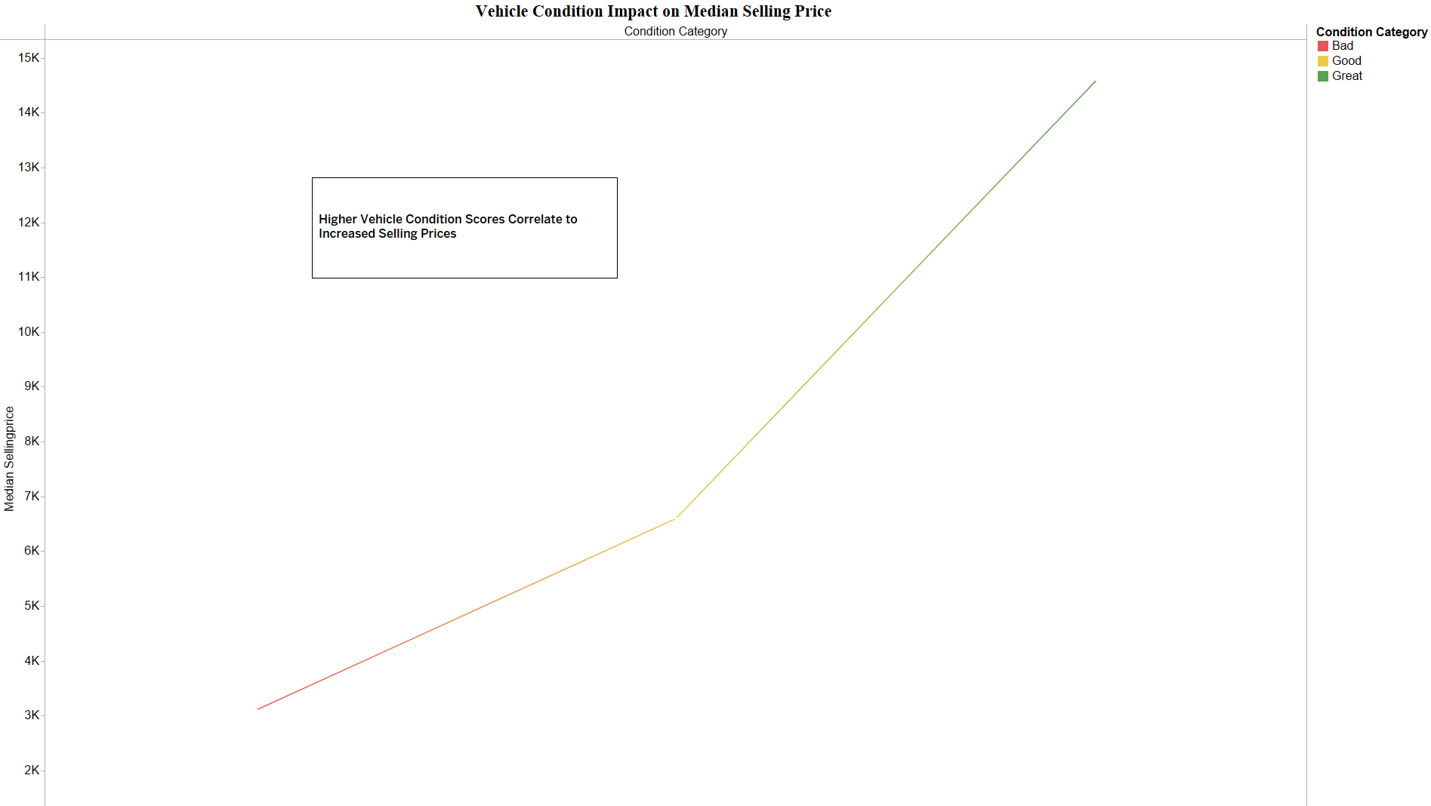

Slide 9
Navigating the Geographical Landscape of Auto Sales
Sales Distribution: Distribution of vehicle sales across different states.
Regional Strengths: Which regions are performing strongly and contributing factors.
Market Opportunities: Regions with growth potential and strategies to capture market share.
Trends and Preferences: Trends, such as preferences for vehicle types or features, and their implications for targeted marketing.

Slide 10
